Slide 1
Simplification of CFG
Removal of Useless Symbols
-- Sakshi Surve

Slide 2
Simplification of CFG :
Various languages can efficiently be represented by a context-free grammar.
All the grammar are not always optimized that means the grammar may consist of some extra symbols(non-terminal).
Having extra symbols, unnecessary increase the length of grammar.
Simplification of grammar means reduction of grammar by removing these extra symbols.
Notes:
https://www.javatpoint.com/automata-simplification-of-cfg

Slide 3
In a CFG, may it happen that all the production rules are not needed for derivation of strings
Elimination of such strings is called “Simplification of CFG”
By Simplifying, we remove all the unnecessary, redundant productions while keeping the transformed grammar equivalent to the original one.
Simplified form can remove ambiguity and improve G

Slide 4
The properties of reduced grammar are given below:
Each variable (i.e. non-terminal) and each terminal of G appears in the derivation of some word in L.
Useless Symbols
There should not be any production as X → Y where X and Y are non-terminal.
Unit Productions
If ε is not in the language L then the production X → ε need not be there .
Null Productions

Slide 5
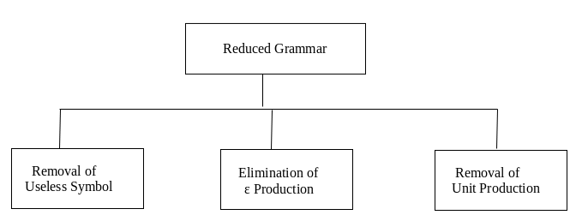
Three ways to Simplify the Grammar :

Slide 6
1. Removal of Useless Symbols :
Useful Symbol (NT) :
Appears on the LHS of the production rule
It generates some terminal symbol
P =>* a
Useless Symbol :
It does not appear on the right-hand side of the production rule (It is not reachable from the start symbol)
It is not live (It doesn’t derive a string )
A production rule is Useless if it involves any Useless Symbols

Slide 7
Steps For reduction of a given grammar G:
Identify Non-generating symbols in the given CFG and eliminate those productions which contains non-generating symbols….Symbols not deriving any string
Identify Non-reachable symbols and eliminate those productions which contain the non-reachable symbols
Notes:
https://www.sanfoundry.com/automata-theory-cfg-eliminating-useless-symbols/

Slide 8
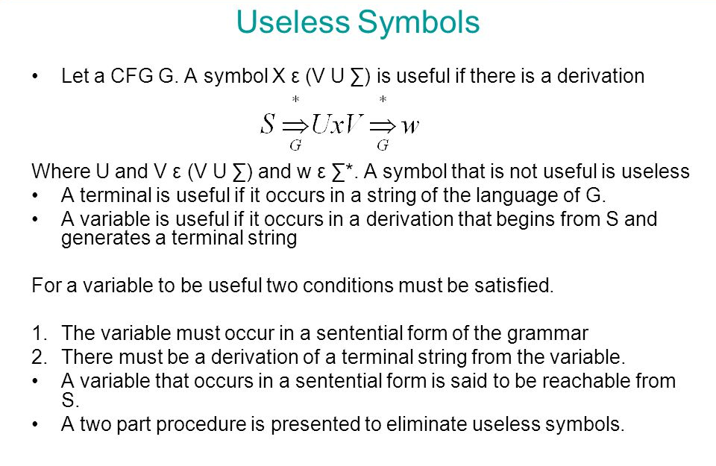

Slide 9
Example 1: Remove the useless symbol from the given context free grammar: S -> aB / bX A -> Bad / bSX / a B -> aSB / bBX X -> SBD / aBx / ad Solution:
A and X directly derive string of terminals a and ad, hence they are useful.
Since X is a useful symbol so S is also a useful symbol as S -> bX.
But B does not derive any string w … so clearly B is a non- generating symbol.
So eliminating those productions with B in them we get S -> bX A -> bSX / a X -> ad
In the reduced grammar A is a non-reachable symbol so we remove it and the final grammar after elimination of the useless symbols is S -> bX X -> ad

Slide 10
The new grammar generates all and only strings generated by the original grammar. Hence it is equivalent to the original grammar.
The equivalent grammar G’ can be represented as :
G’ = ( S, V’, P’, T )
Where
S = S
V ’ = { S, X }
T = { a, b }
P ’ =
{ S -> bX X -> ad
}

Slide 11
Example 2 : Find the equivalent useful grammar from the given grammar A -> xyz / Xyzz X -> Xz / xYz Y -> yYy / Xz Z -> Zy / z Solution :
A and Z is a useful symbol as it can be derived to a string of terminal symbol (Z -> z and A -> xyz).
X and Y are not useful.
So all the production with X and Y in them should be removed to eliminate non-generating symbols.
The grammar then becomes A -> xyz Z -> Zy / z
Since A is the starting symbol this implies Z is the non-reachable symbol.
So we remove it to get a grammar free of useless symbols: A -> xyz

Slide 12
Example 3 : S -> AB/a
A -> BC/b
B -> aB/C
C -> aC/B
Solution:
Symbol B and C are useless symbol, remove them (whole production in which they are present)
So, Useful Symbols: {a, b, S, A} And any combination of useful symbols will also make LHS a useful symbol.
S -> a
A -> b But cause A is not reachable so we will remove A -> b as well, the final production is :
S -> a
Notes:
https://scanftree.com/automata/elimination-of-useless-symbol-from-context-free-grammar

Slide 13
Example 4: S -> AB/AC
A -> aAb/bAa/a
B -> bbA/aaB/AB
C -> abCA/aDb
D -> bD/aC
Solution:
First find out useful Symbols: {a, b, A, B, S}
And useless symbols are: {C, D}
So remove them and write the whole grammar again:
S -> AB
A -> aAb/bAa/a
B -> bbA/aaB/AB

Slide 14
Example 5:
S -> AB | B |a A -> aA B -> b
Solution :
S -> B | a B -> b

Slide 15
Example 6:
S-> abS | abA | abB
A-> cd
B-> aB
C-> dc
Solution :
S-> abS | abA
A-> cd

Slide 16
Example 7:
S-> aAa | aBC
A-> aS | bD
B-> aBa | b
C-> abb | DD
D-> aDa
Solution :
S-> aBC | aAa
A-> aS
B-> aBa | b
C-> abb

Slide 17
Example 8:
T-> aaB | abA | aaT
A-> aA
B-> ab | b
C-> ad
Solution :
T-> aaB | aaT
B-> ab | b

Slide 18
S-> BS | B
A-> aF
B-> b
F-> bB | b
Example 9:
S-> AC | BS | B
A-> aA | aF
B-> CF | b
C-> cC | D
D-> aD | BD | C
E-> aA | BSA
F-> bB | b
Solution :
S-> BS | B
B-> b

Slide 19
Example 10 :
S-> EA
A-> abA | ab
C-> EC | Ab
E -> bC
G-> EbE | CE | ba
Solution :
S-> EA
A-> abA | ab
C-> EC | Ab
E -> bC

Slide 20
After removing the non generating non terminals, the grammar becomes :
S-> aS | A
A-> a
B-> aa
Example 11 :
S-> aS | A | C
A-> a
B-> aa
C-> aCb
Solution :
After removing the non reachable non terminals, the grammar becomes :
S-> aS |A
A-> a

Slide 21
Example 12 :
S-> aA | bB
A-> aA | a
B-> bB
D -> ab | Ea
E-> aE | d
Solution :
S-> aA
A-> aA | a

Slide 22
Example 13 :
S-> AB | CA
A-> a
B-> BC | AB
C -> aB | b
Solution :
S-> CA
A-> a
C->a

Slide 23
Example 14 :
S-> aA | a | Bb | CC
A-> aB
B-> a | Aa
C -> cCD
D-> ddd
Solution :
S-> aA | a | Bb
A-> aB
B-> a | Aa

